Slide 1
Digital Forensics with Open Source Tools
Dr. Iftikhar Alam
Recommended Book by Cory and Harlan

Slide 2
Open Source vs Proprietary
Advantages vs Disadvantages
Why Paid?
Why Free?

Slide 3
Cont…
To provide findings, we must be able to trust our tools
Open Source License
The two most commonly used licenses are the GNU (GNU's Not Unix) Public License (GPL) and the Berkeley Software Distribution License (BSD).

Slide 4
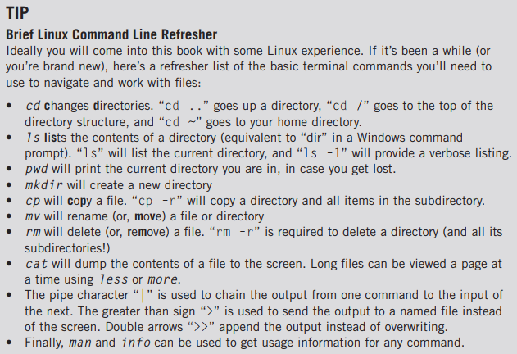
Ubuntu is used as OS in the book
We will use the Ubuntu package manager apt to install software throughout the book;
Some Linux Commands

Slide 5
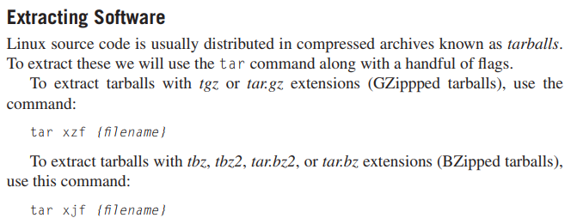
Extracting Software

Slide 6
Languages setup
C, C++
Python
Ruby
Perl
etc

Slide 7
Disk and File System Analysis
forensic analysis deals with fles on media
deleted files, files in folders, files in other files, all stored on or in some container.
File System Abstraction Model
Disk
Volume
File System

Slide 8
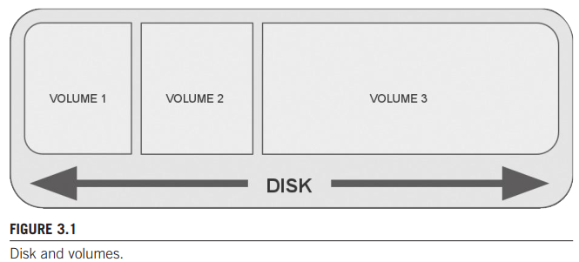
Cont…

Slide 9
Cont…
Data Unit Historically the sector size of every disk was 512 bytes—most modern file systems will use 4096 bytes (4K) or larger as the smallest addressable data unit. The information available at the data unit layer is simple: the content of that data unit. If that data unit is allocated to a JPEG image, the data unit will contain a portion of JPEG data. If the data unit was allocated to a text file, the data unit will contain text.

Slide 10
Cont…
Metadata Metadata refers to data about data.
https://www.sleuthkit.org/

Slide 11
Windows systems and artifacts
Windows FILE Systems
FAT-8, 16, 32
NTFS-32 and 64, 128
Microsoft states that the FAT32 file system can support disks up to 2 terabytes (TB)

Slide 12
NTFS advantages over FAT
To set access control lists (ACLs, or permissions) on file objects, journaling, compression, and a host of other capabilities not offered on the FAT file system.

Slide 13
Windows registry
RegRipper

Slide 14
Linux Systems and Artifacts
Practical after installation

Slide 15
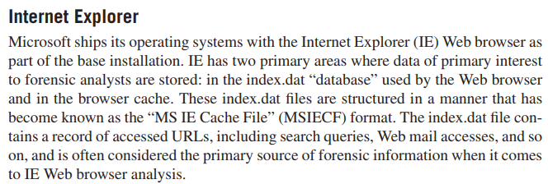
Internet Artifacts
• Browser Artifacts • Mail Artifacts
well-known open source tools for parsing index.dat files is Pasco from FoundStone (Pasco can be downloaded from http://sourceforge.net/projects/fast/fles/Pasco/).
pasco from FoundStone

Slide 16
Cont…
Cookies
Cache

Slide 17
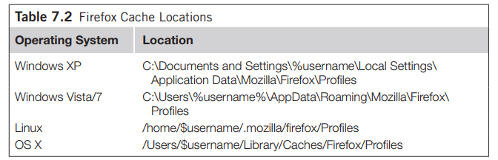
Firefox session data

Slide 18
Bookmarks and Bookmark Backups
Extensions and Plugins

Slide 19
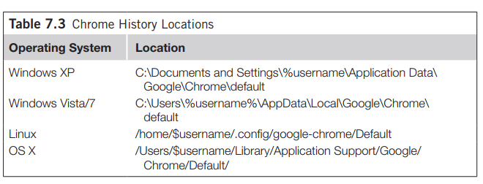
Chrome

Slide 20
End of lecture

